Slide 1
Problem Statement : AR Open Innovation
Problem Statement Number:PS16 Team Name : Warlocks Team Leader Name : Tamizhiniyan S R
College Name: SRM Institute of Science and Technology

Slide 2
Problem Statement
On the onset of the pandemic, a number of fields that prioritized, nay mandated, physical interaction with customers such as the construction and real-estate industry, are crumbling do to the lack thereof.
It has become a necessity for such work cultures to embrace the world of the virtual and implement strategies that not only tackle the "customer's physical presence is a must" mindset of such industries, but further buttress the previously elucidated advantages of working "virtually".

Slide 3
Idea / Approach details
To combat such a situation, we have devised an infrastructure platform that has the capacity to support a number of occupations that rely on a more 'hands-on' work ethic.
Using cutting edge Augmented Reality technology powered by AR Cloud Service Echo AR, which allows for the placement and view of real-estate in real-time, the application allows for the collaboration of all fields within the ‘infrastructure’ realm to provide a succinct view of multiple renditions of the house, including the finished, unfinished and an under construction view.
Tech Stack:
Echo AR
Unity Engine
Blender
Android (v7 and above) Device with ARCore support

Slide 4
Application
A real-time Augmented Reality application which renders multiple infrastructural models in worldspace through Android Devices with an ARCore enabled Camera.
AR modules include 1:1 scale interactable and explorable models. These modules can be selected manually by the user through the UI menu.
The modules consist of:
Furnished 1:1 scale model of a House with a UI overlay
Empty 1:1 scale model of a House with a UI overlay
1:1 scale model of a House with structural details such as layout and sizes.
Additional echoARbuddy app includes Construction Phases expressed through 3D models created in Blender and rendered through the echoAR console

Slide 5
Day 2 additions
Implementation of additional AR Modules/Scenes through Unity Engine
Addition of a barebones User Interface and Prototyping
3D Model Creation in Blender( Various Stages )
Addition of Models to the echoAR platform
UI Creation using Affinity Designer (illustration tool)
Final UI implementation

Slide 6
Day 3 additions
We started out with an aim to create an immersive AR experience. Our initial project idea was an AR Portal which would present the user with a real-time render of the interior of the models.
Problems faced:
We realized this solution doesn’t accurately represent a real-estate demonstration.
We faced problems with multiple mask renders.
Started coding the solution and modelling the preview models on C4D only to face export issues, therefore changing our tool to Blender.
We acquired new skills such as:
Animating UI in Unity and quick scene transitions for better UX
Advanced modelling and texture baking in Blender
EchoAR SDK and seamless implementation
Model runtime implementation in Unity using Echo AR SDK
ARCore Cloud Anchors (GPS Trackers)

Slide 7
Upon consulting with Mentor who suggested we increase the scope of our solution we added new and improved functionalities such as:
Easy addition of Custom models using EchoAR console
Addition of EchoAR APIs in the client side application
Construction phase previews
Finally we reviewed our code, prototyped our application and committed the changes to our github repository.

Slide 8
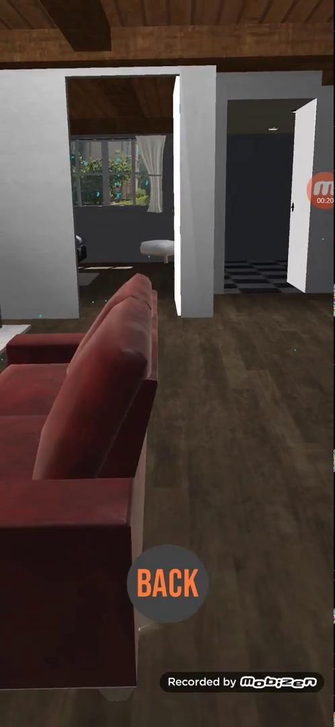
Demo

